Slide 1
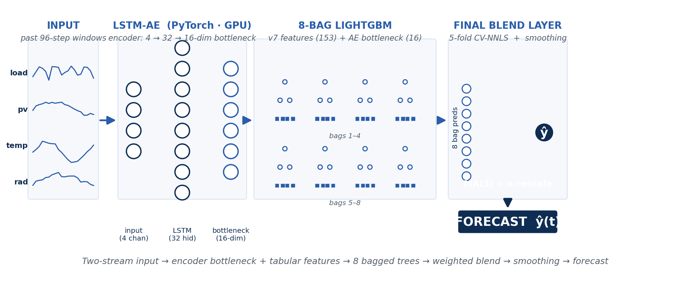
01
Forecasting model
2025 test set · April + September · 5760 timesteps
52.17%
0.470 kW
0.283 kW
48 / 57 %
NRMSE (★ primary)
RMSE
MAE
NRMSE Apr / Sept

Slide 2
02
Controller approach · Rolling-horizon MPC, H = 96
MPC LOOP — at each 15-min step
OPTIMIZER
scipy.optimize.linprog (HiGHS)
1
Get load forecast for next H = 96 steps (24 h)
→ Linear program — convex, polynomial-time, single global optimum → Open-source, deterministic, ~10 ms per H=96 solve → No MIP needed: at non-negative tariffs, LP picks one direction naturally
2
Solve LP — 481 vars: p_chg, p_dis, p_imp, p_exp, soc
3
Apply hard constraints — SoC ∈ [0,1], ±8 kW battery, ±6 kW grid
WHY H = 96 (24-hour horizon)
4
Execute first action only (discard the rest)
H
Bill (€)
vs A
5
Update SoC from realised battery action, advance to t+1
4
+63.71
+71
24
+6.22
+14
48
−16.71
−9
96
−18.89
−11
Captures full F3-night → F1-day arbitrage cycle.

Slide 3
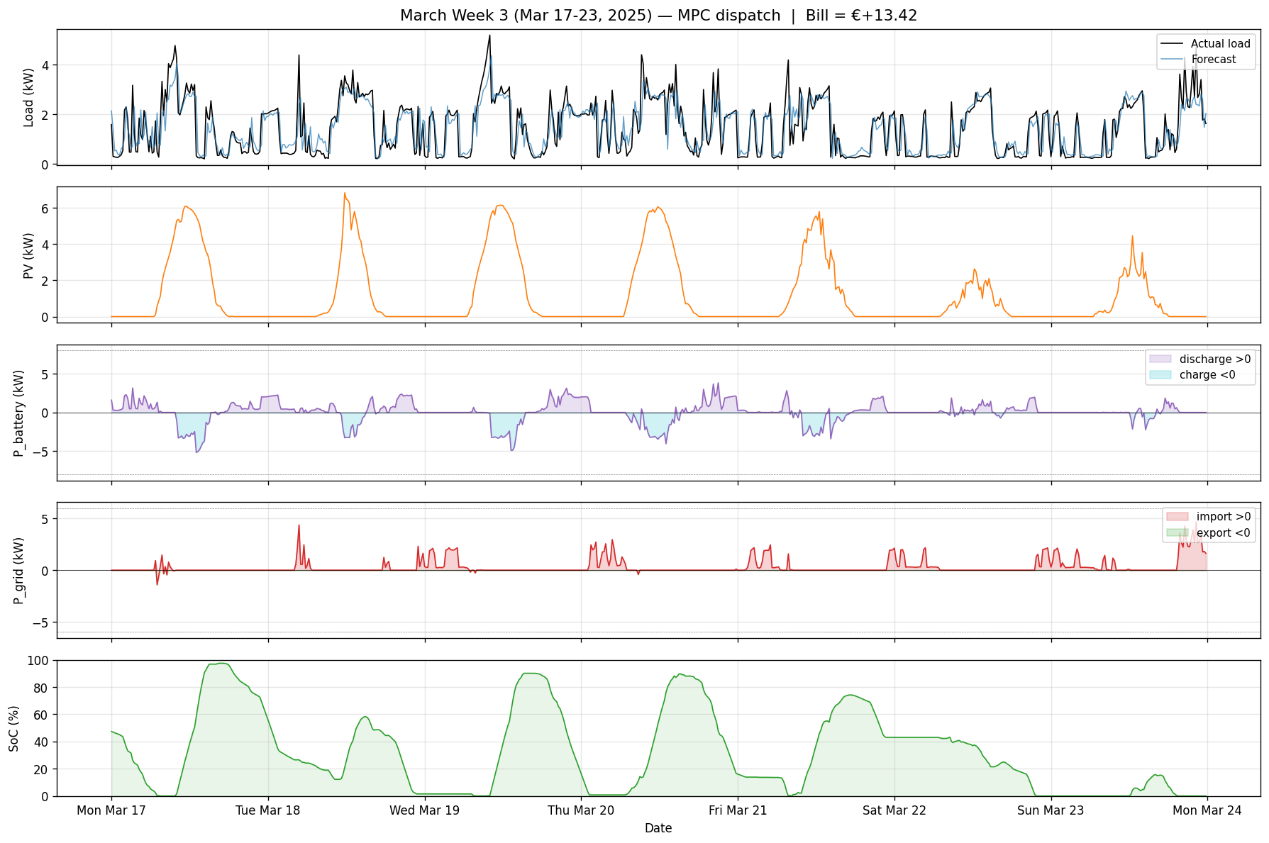
03
March Week 3 dispatch · Mar 17 – 23, 2025
All hard constraints respected: battery [-5.2, +3.8] kW (limit ±8) · grid [-1.4, +4.7] kW (limit ±6) · SoC [0%, 97.5%]

Slide 4
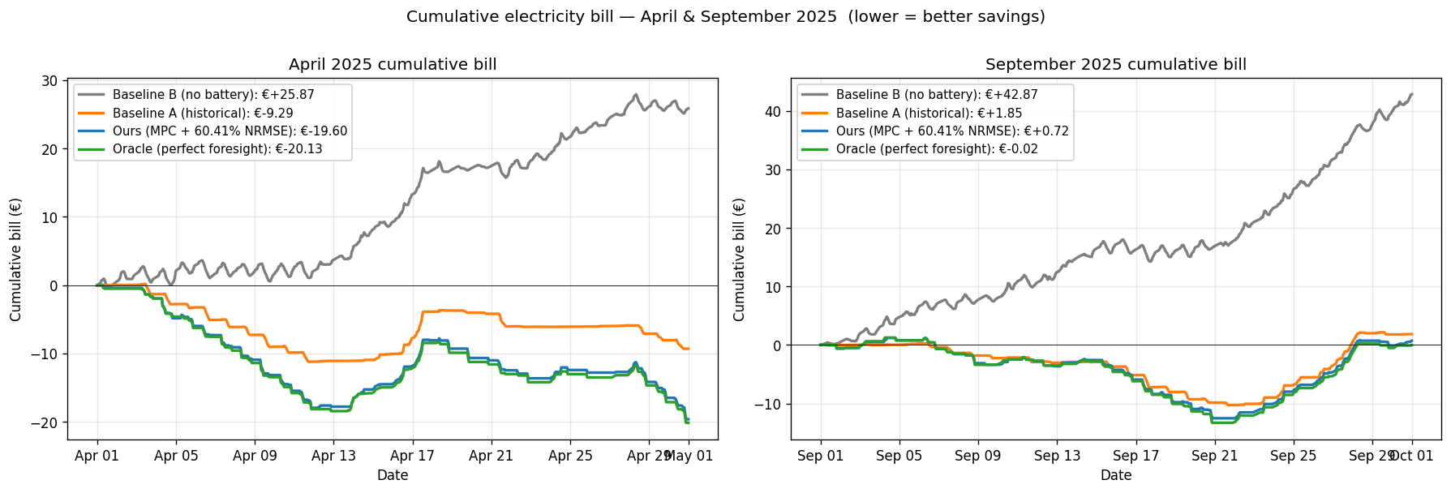
04
Results · 90% of oracle savings · +154% vs Baseline A
Bill summary (Apr + Sept, H=96)
Method
Total
Baseline B (no battery)
€+68.74
Baseline A (historical)
€-7.44
Our controller (MPC)
€-18.89
Oracle (perfect)
€-20.14
Cumulative electricity bill — April + September 2025
Savings vs Baseline A
+€11.45 (+154%)
Oracle gap
€1.26 (90% captured)
✓ Extension 1 done (H sweep 4 → 96)

Slide 5
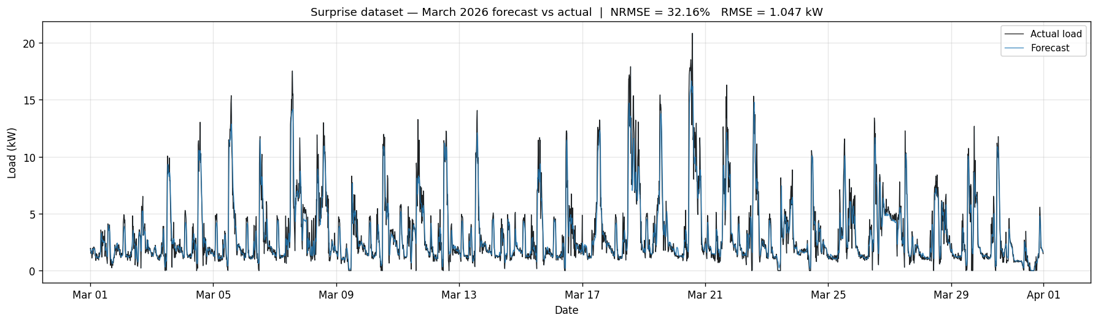
05
Generalization · surprise dataset (March 2026)
Surprise dataset NRMSE
32.16%
down from 52.17% on 2025
March 2026 surprise dataset — full month
RMSE
1.05 kW
MAE
0.63 kW
Same architecture — no retuning, just rebuilt features and refit on the new site (3× larger consumer → better signal-to-noise).

Slide 6
06
Hardest problem · Next steps
HARDEST PROBLEM
NEXT STEPS
NRMSE ≠ Bill
Given one more day
We discovered a Pareto trade-off: smoothing the forecast lowered NRMSE (60.4 % → 52.2 %), but the LP under-charged before peaks, raising the bill (−€18.89 → −€18.23). NRMSE penalises errors symmetrically, but the bill is asymmetric in peak timing.
Decision-focused loss
Train the forecaster directly on the bill (SPO+ — Elmachtoub & Grigas, Mgmt Sci 2022).
PV forecast fusion
Pair load forecast with a separate PV model using ARPA radiation directly.
Tariff-band-aware smoothing
FIX — spike-preserving coring
Smooth only F3 hours; keep F1 raw for peak fidelity.
Smooth where |raw − MA(3)| < 0.4 kW (= noise), keep raw where |residual| > 0.4 kW (= real spike). → Pareto win: NRMSE 60.4 → 57.8 % AND bill −€18.89 → −€18.91
Battery degradation cost
Add cycle-count penalty to LP (already wired, set to 0 here).
Ahmed Mohamed Bayoumi · Team 25 · Energy AI Hackathon 2026

